Slide 1
ROBOT NAVIGATION IN A DYNAMIC ENVIRONMENT USING QL AND DQL UNIVERSITY OF MARYLAND -PRANAV ANV -MANOJ KUMAR SELVARAJ

Slide 2
Goal or Objective: The objective is to navigate a robot through a dynamic environment, To reach from the start to the goal point using Q-Learning and Deep Q-Learning. Upon completion, the results obtained from both methods will be compared. Python will serve as the programming language for the implementation, while Pygame will be used as the simulation platform. For Deep Q-Learning, the necessary neural network models will be created using PyTorch , which is a popular deep learning framework.

Slide 3
Algorithms: Q Learning: Q-learning is a model-free reinforcement learning algorithm that seeks to find the best action to take given the current state. It's considered model-free because it doesn't require a model of the environment, that is, it doesn't need to know the transition probabilities from one state to another (which would be the case in model-based methods). Instead, it aims to learn the value of an action in a particular state based on the reward outcome, which it experiences directly by interacting with the environment. By utilizing observable rewards and transitions to update Q-values, the robot agent in Q-Learning determines the best course of action. The location and orientation of the robot are represented by the state space, and movement commands are reflected in the actions. Through iterative exploration and updates, Q-values allow the agent to travel towards goals while avoiding barriers by predicting the expected payoff for specific actions from given states

Slide 4
Implementation
Initialization: A QLearningAgent class is created with its own Q-table that stores the estimated rewards for state-action pairs.
State Representation: The get_state method generates a state representation from the agent's perspective.
Action Selection: The choose_action method is where action selection happens. If the current state is not in the Q-table, a new entry is created.
Learning: After the agent takes an action and receives a reward, the update_q_value method updates the Q-value for the state-action pair in the Q-table.
Exploration Rate Decay: Gradually shifting from exploration to exploitation is achieved by the decay of the exploration rate as learning proceeds.

Slide 5
Outcome
Q-learning enables an agent to navigate through a dynamic environment by learning from interactions with the environment, updating a Q-table to maximize future rewards. This approach uses a balance of exploration and exploitation without requiring a model of the environment.
A more calculated strategy based on the knowledge gathered from the Q-table is made possible as the agent's exploration rate decreases with time. As a result, the route to the objective becomes more and more optimal, adjusting to environmental changes like shifting impediments.

Slide 6
Deep Q-Learning
Deep Q-Learning is a variant of Q-learning, which is a model-free reinforcement learning algorithm, that uses deep neural networks to approximate the action-value function (Q-function). The algorithm aims to maximize the expected cumulative reward for an agent interacting with an environment. It combines Q-learning's approach to learning optimal policies through Q-values with the function approximation capabilities of deep neural networks.
Implementation:
Initialize Networks and Replay Buffer: Set up the Q-network and target network, and initialize a replay buffer.
2. Collect Experience: Observe the state, select an action, perform it, and store the experience (state, action, reward, next state).
3. Sample from Replay Buffer: Periodically sample a batch of experiences from the replay buffer.
4. Train Q-Network: Calculate target Q-values using the target network, compute loss, and update the main Q-network.
5. Update Target Network: Regularly synchronize the target network's weights with the main Q-network's weights

Slide 7
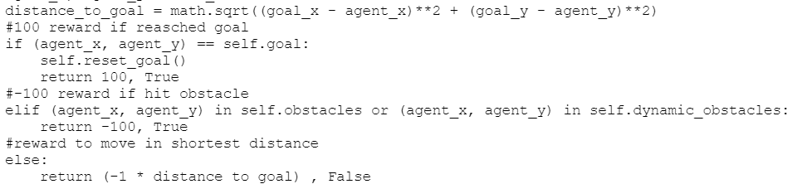
DQL Architecture
Improvements:
Improved the layers of NN. DQL consist of 2 ,64 Hidden Layers with ReLu activation.
Used ray sensor with limited range as sensor readings. (range <=1 cell grid).
Rewards are chosen such that the distance to reach the goal is shorter.
Used a replay buffer to store experiences (state, action, reward, next state) and learn from them using batch updates.
Input Layer
Output Layer
64 Hidden ReLu
64 Hidden
ReLu

Slide 8
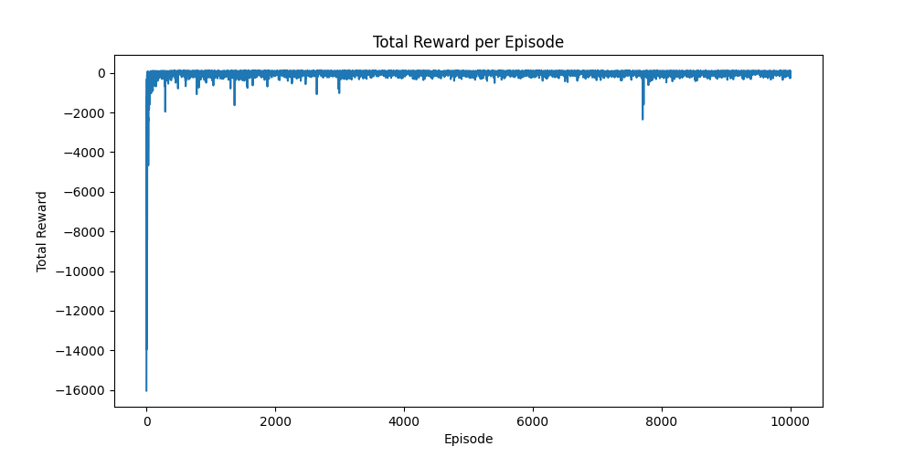
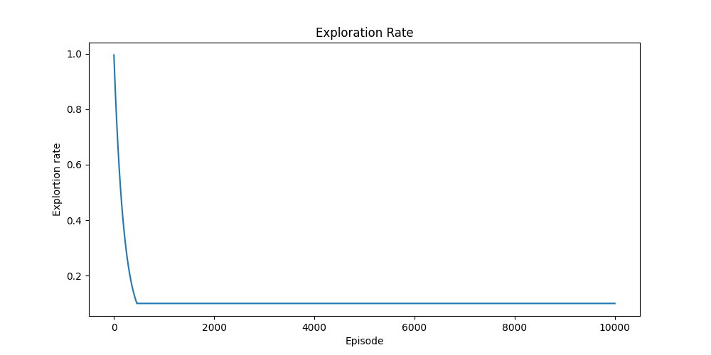
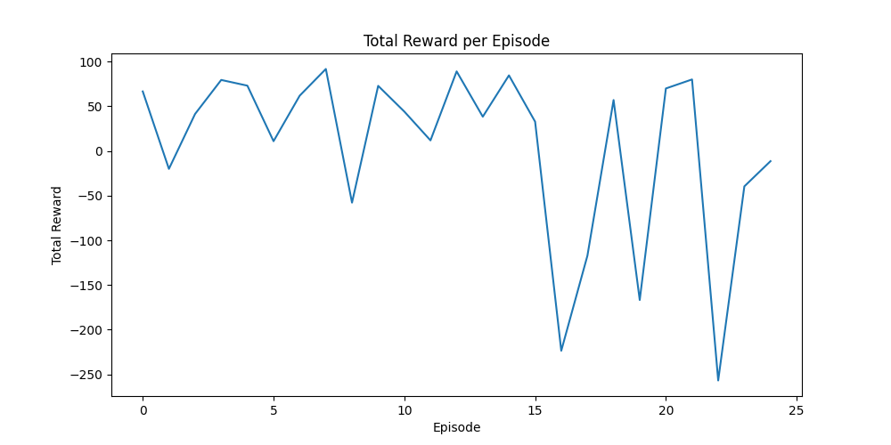
Performance Training:
Testing:
Demo Video:
https://drive.google.com/file/d/1A_CswYDB5gAEbK1yeVwowI6KVEVEddWb/view?usp=sharing

Slide 9
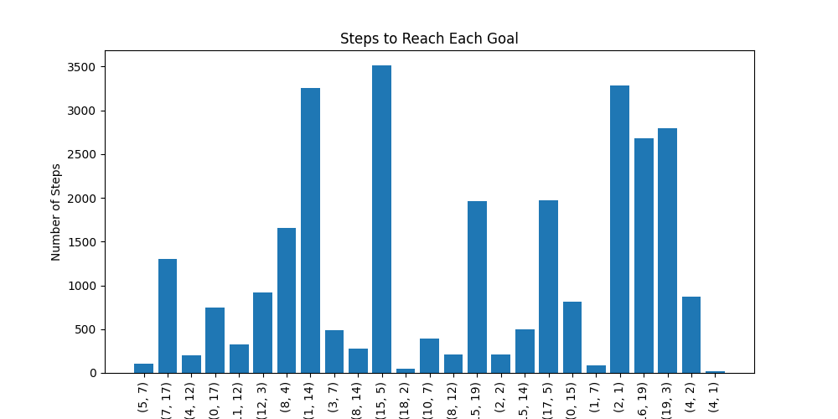
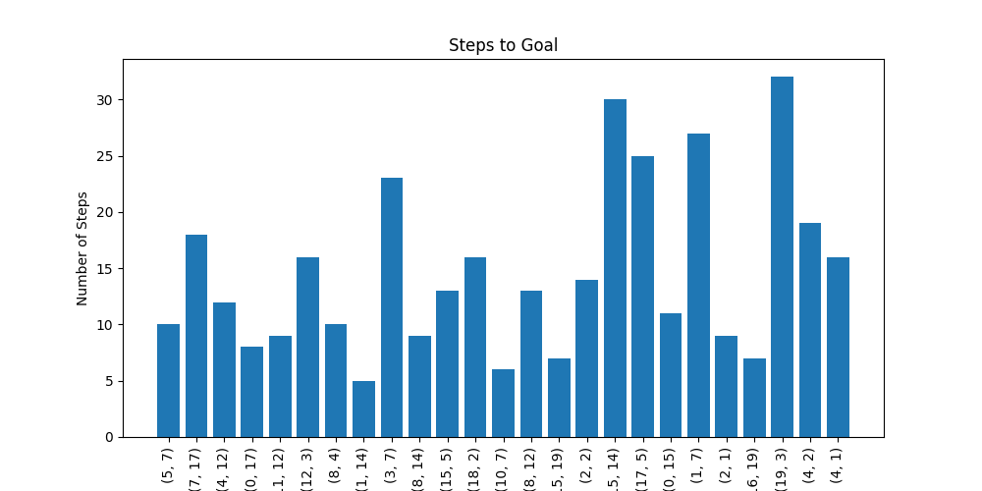
Q-Learning Vs Deep Q-Learning:
Q-Learning steps to reach Goal
Deep Q-Learning steps to reach Goal
By comparing Q-Learning with Deep Q-Learning it is evident that the steps taken to reach the goal in DQL are way lesser than Q-Learning.

Slide 10
THANK YOU

